Slide 1
Improved protein model quality assessment by integrating sequential and pairwise features using deep learning
Bioinformatics Xiaoyang Jing,Jinbo Xu 2020
汇报人：朱君咏
日期：2021.6.7

Slide 2
01
Introduction
02
Feature extraction
目录
03
DNN architecture
04
Results

Slide 3
Introduction
1D ResNet + 2D ResNet →Deep Network
sequential features
pairwisel features
ResNetQA

Slide 4
Features
From protein sequence
sequential features
coevolution information
predicted distance potentials
ccmpredZ
sequence ,rPosition,ACC,SS3(by RaptorX-Property),PSSM
DistPot by RaptorX-Contact
From protein model
SS3,RSA(by DSSP)
distance maps of three atom pairs (CaCa, CbCb and NO)
sequential features
pairwisel features

Slide 5
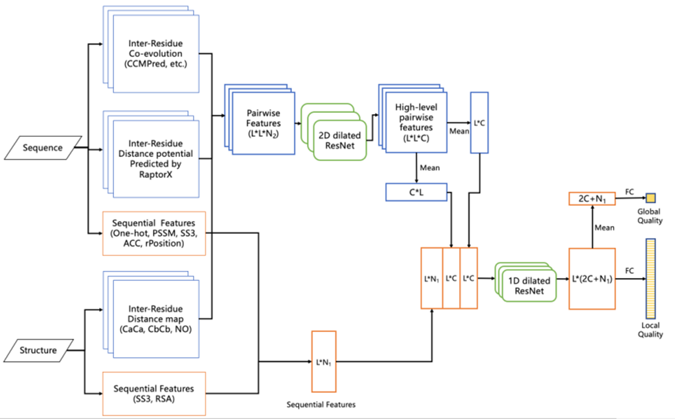
Deep neural network architecture
2D ResNet blocks extracts useful information from pairwise features;
1D ResNet blocks predict
quality from sequential features and pairwise information produced by the 2D ResNet module.

Slide 6
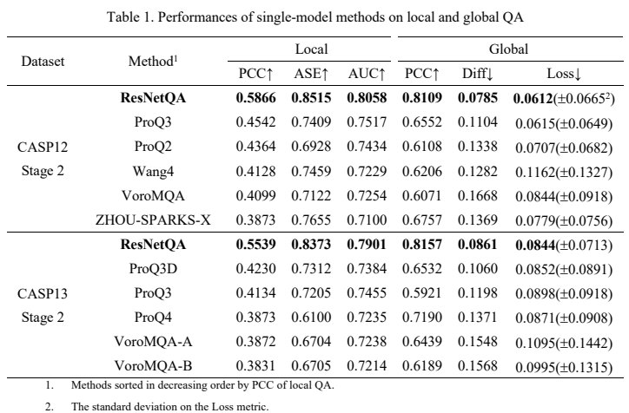
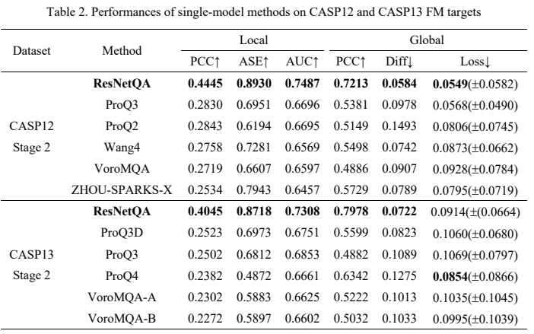

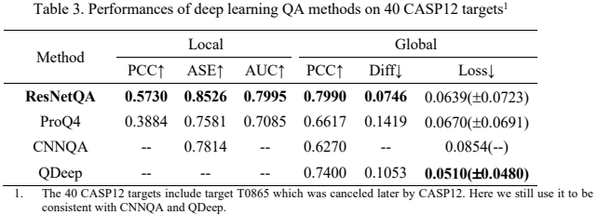
Results
ResNetQA√

Slide 7
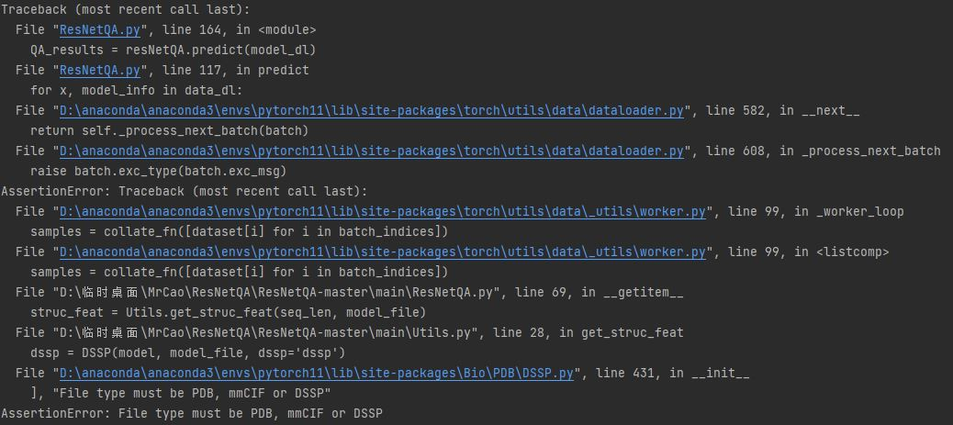

Slide 8
感谢您的倾听与观看

